Slide 1
Line Drawing Algorithm
(DDA Algorithm)
Computer Graphics
Shahnaj Parvin
Lecturer

Slide 2
DDA Algorithm
DDA (Digital Differential Analyzer) is a line drawing algorithm used in computer graphics to generate a line segment between two specified endpoints.
It is a simple and efficient algorithm that works by using the incremental difference between the x-coordinates and y-coordinates of the two endpoints to plot the line.

Slide 3
DDA Algorithm Procedure
Given-
Starting coordinates = (X₀, Y₀)
Ending coordinates = (X_{n}, Y_{n})
The points generation using DDA Algorithm involves the following steps-

Slide 4
DDA Algorithm Procedure
Step-01:
Calculate ΔX, ΔY and M from the given input. These parameters are calculated as-
ΔX = X_{n} – X₀
ΔY =Y_{n} – Y₀
M = ΔY / ΔX

Slide 5
DDA Algorithm Procedure
Step-02:
Find the number of steps or points in between the starting and ending coordinates.
if (absolute (ΔX) > absolute (ΔY))
Steps = absolute (ΔX);
else
Steps = absolute (ΔY);

Slide 6
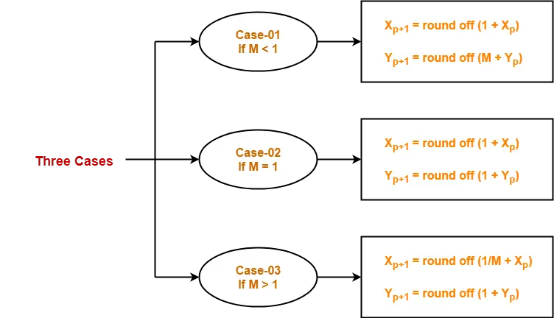
DDA Algorithm Procedure
Step-03:
Suppose the current point is (X_{p}, Y_{p}) and the next point is (X_{p+1}, Y_{p+1}).
Find the next point by following the below three cases-

Slide 7
DDA Algorithm Procedure
Step-04:
Keep repeating Step-03 until the end point is reached or the number of generated new points (including the starting and ending points) equals to the steps count.

Slide 8
Practice Problem (DDA Algorithm )
Problem 01: Calculate the points between the starting point (5, 6) and ending point (8, 12).

Slide 9
Practice Problem (DDA Algorithm )
Problem 01: Calculate the points between the starting point (5, 6) and ending point (8, 12).
Solution-
Given-
Starting coordinates = (X₀, Y₀) = (5, 6)
Ending coordinates = (X_{n}, Y_{n}) = (8, 12)

Slide 10
Practice Problem (DDA Algorithm )
Problem 01: Calculate the points between the starting point (5, 6) and ending point (8, 12).
Step-01:
Calculate ΔX, ΔY and M from the given input.
ΔX = X_{n} – X₀ = 8 – 5 = 3
ΔY =Y_{n} – Y₀ = 12 – 6 = 6
M = ΔY / ΔX = 6 / 3 = 2

Slide 11
Practice Problem (DDA Algorithm )
Problem 01: Calculate the points between the starting point (5, 6) and ending point (8, 12).
Step-02:
Calculate the number of steps.
As |ΔX| < |ΔY| = 3 < 6, so number of steps = ΔY = 6

Slide 12
Practice Problem (DDA Algorithm )
Problem 01: Calculate the points between the starting point (5, 6) and ending point (8, 12).
Step-03:
As M > 1, so case-03 is satisfied.
Now, Step-03 is executed until Step-04 is satisfied.

Slide 13
Practice Problem (DDA Algorithm )
Problem 01: Calculate the points between the starting point (5, 6) and ending point (8, 12).
X_{p} | Y_{p} | X_{p+1} | Y_{p+1} | Round off (X_{p+1}, Y_{p+1})
5 | 6 | 5.5 | 7 | (6, 7)
 |  | 6 | 8 | (6, 8)
 |  | 6.5 | 9 | (7, 9)
 |  | 7 | 10 | (7, 10)
 |  | 7.5 | 11 | (8, 11)
 |  | 8 | 12 | (8, 12)

Slide 14
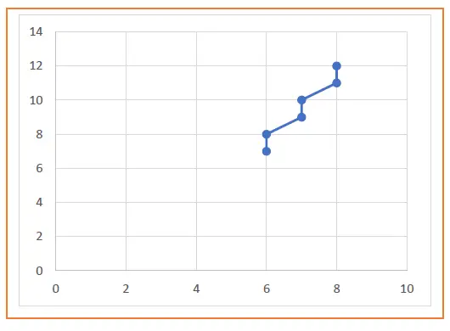
Practice Problem (DDA Algorithm )
Problem 01: Calculate the points between the starting point (5, 6) and ending point (8, 12).

Slide 15
Practice Problem (DDA Algorithm )
Problem 02: Calculate the points between the starting point (5, 6) and ending point (13, 10).

Slide 16
Practice Problem (DDA Algorithm )
Problem 02: Calculate the points between the starting point (5, 6) and ending point (13, 10).
Solution-
Given-
Starting coordinates = (X₀, Y₀) = (5, 6)
Ending coordinates = (X_{n}, Y_{n}) = (13, 10)

Slide 17
Practice Problem (DDA Algorithm )
Problem 02: Calculate the points between the starting point (5, 6) and ending point (13, 10).
Step-01:
Calculate ΔX, ΔY and M from the given input.
ΔX = X_{n} – X₀ = 13 – 5 = 8
ΔY =Y_{n} – Y₀ = 10 – 6 = 4
M = ΔY / ΔX = 4 / 8 = 0.50

Slide 18
Practice Problem (DDA Algorithm )
Problem 02: Calculate the points between the starting point (5, 6) and ending point (13, 10).
Step-02:
Calculate the number of steps.
As |ΔX| > |ΔY| = 8 > 4, so number of steps = ΔX = 8

Slide 19
Practice Problem (DDA Algorithm )
Problem 02: Calculate the points between the starting point (5, 6) and ending point (13, 10).
Step-03:
As M < 1, so case-01 is satisfied.
Now, Step-03 is executed until Step-04 is satisfied.

Slide 20
Practice Problem (DDA Algorithm )
X_{p} | Y_{p} | X_{p+1} | Y_{p+1} | Round off (X_{p+1}, Y_{p+1})
5 | 6 | 6 | 6.5 | (6, 7)
 |  | 7 | 7 | (7, 7)
 |  | 8 | 7.5 | (8, 8)
 |  | 9 | 8 | (9, 8)
 |  | 10 | 8.5 | (10, 9)
 |  | 11 | 9 | (11, 9)
 |  | 12 | 9.5 | (12, 10)
 |  | 13 | 10 | (13, 10)
Problem 02: Calculate the points between the starting point (5, 6) and ending point (13, 10).

Slide 21
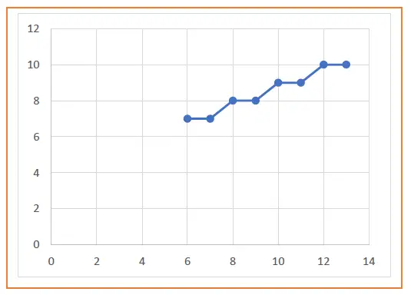
Practice Problem (DDA Algorithm )
Problem 02: Calculate the points between the starting point (5, 6) and ending point (13, 10).

Slide 22
Exercise (DDA Algorithm )
Problem 03: Calculate the points between the starting point (2, 3) and ending point (6, 15).

Slide 23
Exercise (DDA Algorithm )
Problem 04: Calculate the points between the starting point (10, 6) and ending point (15, 9).

Slide 24
Thank You

